Slide 1
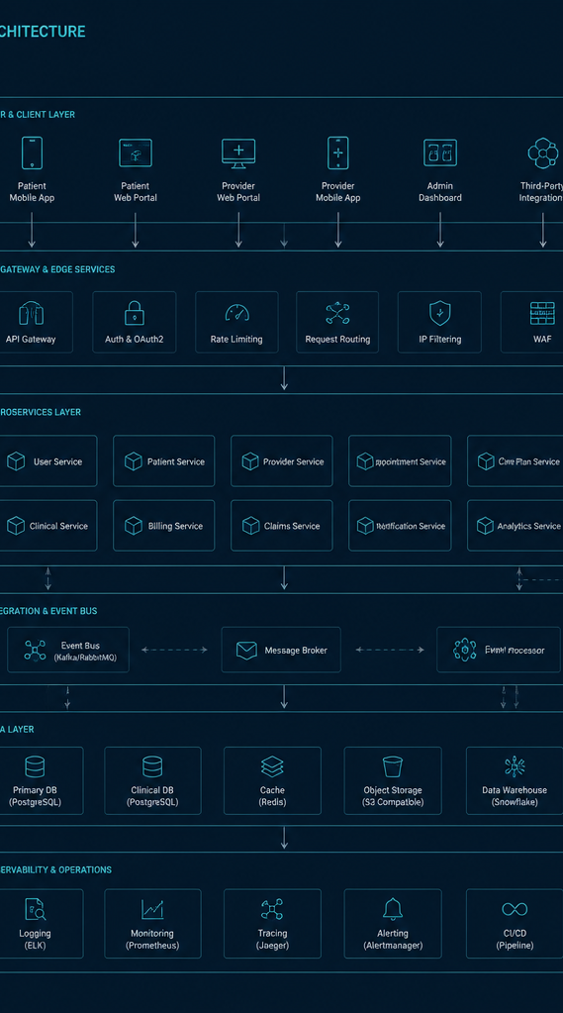
FHIR R4 Platform
From working prototype to enterprise scale. Architecture, implementation, lessons learned, and enterprise performance roadmap.
Paul W. Ford
v1.1.1, August 2026

Slide 2
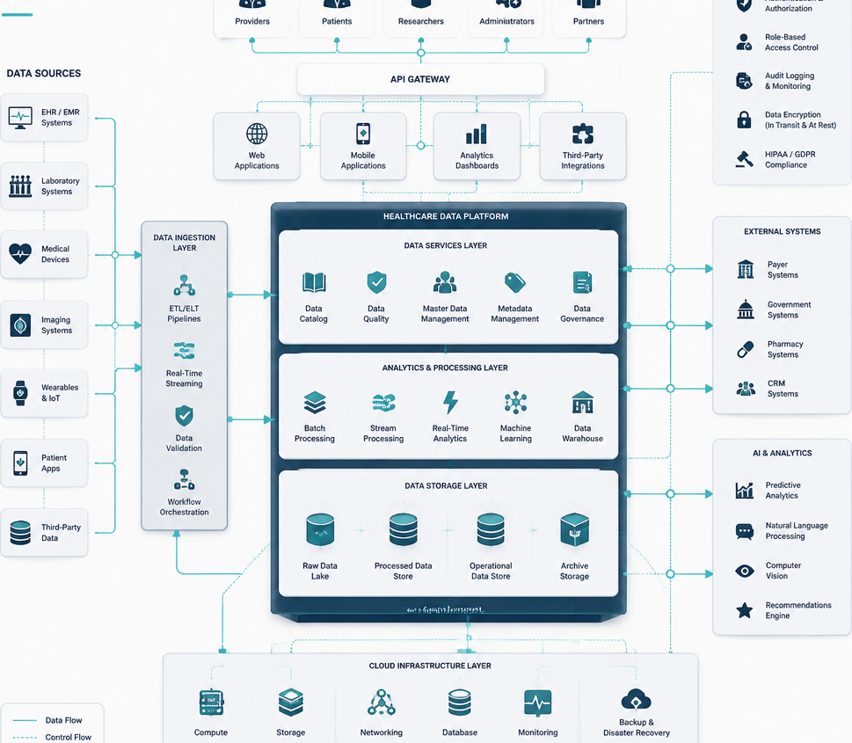
The platform proves the pattern
Enterprise scale requires a stronger operating model
Proven Foundations
A standards-based healthcare platform built from modern open-source components, deployed to cloud with automated CI/CD.
Key Learnings
Environment isolation, API contracts, HTTP behavior, authentication boundaries, repeatable deployment, and smoke tests matter as much as FHIR semantics.
Enterprise Change
Zero-trust security, HA/DR, managed data, horizontal scaling, search/index strategy, async isolation, observability, SLOs, and capacity engineering.
Three-part executive takeaway: Proven, Learned, and Enterprise Change.

Slide 3





Presentation Roadmap
Agenda and Time Allocation
Why FHIR and why this platform
5 min
Architecture and implementation
12 min
Claims workflow and delivery pipeline
8 min
Lessons learned
8 min
Enterprise scale and performance
10 min
Recommendations and close (2 min)

Slide 4

Modernizing Healthcare Interoperability with FHIR
Moving from brittle point-to-point interfaces to a reusable API contract
Healthcare data problem
Fragmented clinical, administrative, and financial data with bespoke mappings and brittle dependencies.
FHIR abstraction
Standard Patient, Encounter, Condition, Claim, and EOB JSON resources, references, coding systems, and REST semantics.
Business outcome: lower integration friction and a reusable base for apps, analytics, automation, and partner exchange.

Slide 5




Four deployable components create an end-to-end learning platform
System Architecture Overview
Admin UI
FHIR server
Data layer
Synthea
React, Vite, Tailwind; resource browser, user admin, API console. Claims demo: guided React workflow with five live FHIR calls and a revenue-cycle story.
Spring Boot plus HAPI FHIR, 15 resource providers, CRUD/search, auth/admin APIs.
MongoDB 7, native JSON/BSON and one collection per resource type.
Creates synthetic FHIR R4 bundles.

Slide 6
System Architecture Topology
Production infrastructure overview using containerized services
Ingress Layer
Data Persistence
Browser requests directed to Caddy TLS/reverse proxy.
CRUD operations performed on MongoDB 7 bound to localhost.
Application Layer
Backup Strategy
Traffic routed to Admin UI nginx or Claims Demo nginx at port 5175.
Scheduled data dumps performed via backup sidecar.
FHIR Server
Spring Boot framework integrated with HAPI.
A deliberately simple topology made the whole system understandable.

Slide 7

FHIR JSON & Document Storage Scaling
Optimizing search design for FHIR resource persistence
FHIR Resource Coverage
Storage Architecture
Technical Advantages
Includes Patient, Encounter, Condition, Observation, Claim, Coverage, EOB, and eight additional resource types.
Utilizes one MongoDB collection per resource type, using the resource ID as the document key and maintaining raw FHIR JSON integrity.
Eliminates relational impedance mismatch, avoids schema migration for extensions/optional fields, and enables direct FHIR-to- JSON persistence.
Enterprise implication: design indexes around actual search parameters, cardinality, tenant boundaries, and query patterns.

Slide 8


Five live calls turn FHIR into a tangible claims story
A sequential workflow for medical claims processing
1 Patient
2 Encounter
3 Condition
register member
office visit
Type 2 diabetes
4 Claim
5 EOB
$150, CPT 99213
$120 insurer paid
Server-assigned UUIDs pass forward as FHIR references.

Slide 9
Layered System Architecture
Separation of concerns across experience, standards, services, data, and runtime
Experience
Admin UI and Claims demo built with React/TypeScript.
API Boundary
FHIR REST and custom admin/auth APIs using HAPI Plain Server and Spring MVC.
Domain Services
Bundle import, Synthea jobs, users, and Spring services/async processing.
Persistence
Dynamic FHIR collections plus users/jobs using Spring Data MongoDB.
Runtime
Containers, reverse proxy, backups, Docker Compose, nginx, and Caddy.

Slide 10
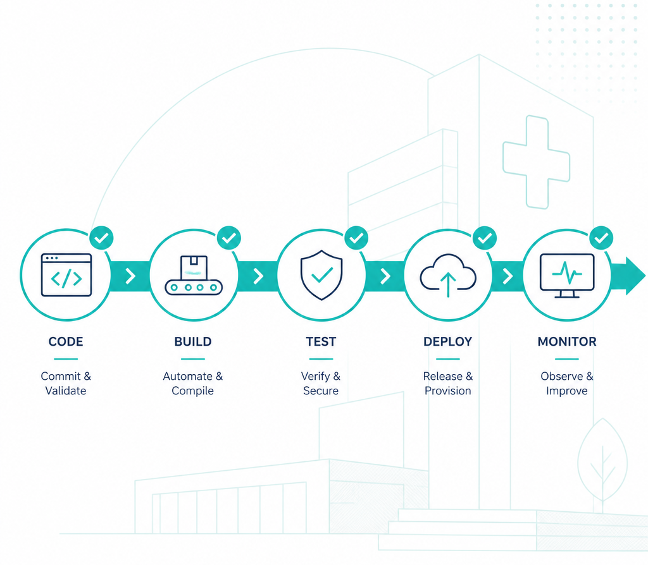
Evolution of the Delivery Pipeline
From code execution to verified production behavior
Pipeline Flow
Code/PR in GitHub; CI with Maven, Vite, Vitest; Docker Compose build gate; staging on self-hosted runner; release by version tag or manual; GHCR registry; production via SSH deploy plus health check.
Automated Testing
49 automated tests cover backend security and paging plus frontend auth, dashboard, pagination, API console, and user management.
Production Smoke Tests
Validate CapabilityStatement, UI, auth, stats, Patient CRUD, and optional Synthea generation.
Key principle: unit tests validate code; smoke tests validate the system users reach.

Slide 11
Security Architecture Assessment
Evaluation of FHIR Boundary Security and Enterprise Readiness
Implemented Security Controls
BCrypt passwords, JWT classification and correct 401/403 behavior, ADMIN-only user creation, environment-specific signing keys, MongoDB on localhost, and dedicated app DB user.
Lessons Learned
Registration privilege escalation was identified and resolved; dev/staging signing-key isolation requires explicit architectural design.
Enterprise Requirements
Transition from permitAll on /fhir/** endpoints to enforcing OAuth2/OIDC, SMART- on-FHIR scopes/consent, gateway policy, TLS, audit trails, secrets management, and least privilege.
Security patterns were sound—but the open FHIR boundary is an enterprise blocker.

Slide 12
The highest-value lessons emerged at component boundaries
Key architectural insights from system integration
Contracts beat assumptions
Nested stats response broke UI until API shape matched.
Environment isolation is a feature
Project names, volumes, ports, databases, and JWT secrets require separation.
HTTP details become architecture
CORS, proxy Origin handling, chunking, Location/ETag, and 401 vs 403 affect workflows.
Build is not deploy is not operate
Live smoke tests close the gap.
Prototype shortcuts become scale bottlenecks
Single-node data, local backups, single- threaded Synthea, and unauthenticated FHIR are learning choices, not enterprise end states.

Slide 13
Current Enterprise Backlog: Compact Deployment
Analysis of existing infrastructure and operational constraints
Availability
Single VPS and MongoDB instance.
Transport
HTTP on bare IP until domain/TLS.
API Security
FHIR endpoints permitAll.
Bulk Workloads
Synthea subprocess and local async executor compete with application resources.
Backups
Local host, seven-day retention risks primary and backup together.
Testing
No browser E2E suite, leaving some integrated flows manual.

Slide 14
Enterprise Architecture Components
Scalable, secure, and observable infrastructure design
Edge & Security
Clients route through WAF and API Gateway, secured by OIDC/SMART scopes.
Compute Layer
Stateless autoscaled FHIR API and Admin API replicas handle ingress traffic.
Data Tier
MongoDB replica sets or sharded clusters with Redis caching and optional search indices; protected by multi-AZ and point-in- time recovery.
Async & Workers
Queue-based architecture to isolate and process background tasks.
Observability
End-to-end monitoring including metrics, logs, traces, audit events, SLOs, synthetics, and capacity telemetry.

Slide 15







Performance work should follow measured workload shapes
Optimizing system architecture and data access patterns
Search/indexes
Profile top searches; compound indexes on identifiers, references, dates, and codes; eliminate scans.
Pagination
Move high-volume queries from offset/skip toward stable cursor/search-after where possible.
API compute
Stateless nodes; tune JVM heap/GC, Tomcat threads, pools; scale horizontally.
Data tier
Replica sets for HA; shard only when justified; choose tenant-plus-access-pattern shard keys.
Cache
CapabilityStatement, terminology/static metadata, and safe read-heavy lookups; never hide poor indexes.
Async
Queue-backed Synthea, imports, exports, notifications, and transformations with backpressure.

Slide 16
Scale each workload independently—not the server as a whole
Optimizing resource allocation for diverse system requirements
Interactive clinical/API
Low latency, bursty reads/writes; scale API replicas, indexes, and cache.
Bulk ingestion
High write throughput and validation cost; use queue, batch workers, controlled concurrency.
Analytics/reporting
Wide scans and aggregation; use replica/warehouse/lake and protect the transactional store.
Terminology/validation
CPU and reference-data intensive; dedicated service/cache and pre-warmed artifacts.
Isolate noisy neighbors and assign explicit concurrency, latency, and resource budgets.

Slide 17



System Reliability and Resilience Strategy
Ensuring continuous availability, data protection, and performance targets
Availability
Data protection
Resilience targets
Multi-AZ load balancing, at least two API replicas, MongoDB replica set/managed service, health and readiness probes, rolling or blue-green deploys.
Point-in-time recovery, encrypted off-host backups, immutable retention, restore automation, backup integrity tests.
Business-backed SLOs and RTO/RPO; exercise node loss, AZ loss, DB failover, queue backlog, rollback, and dependency degradation.
Reliability must be proven through recovery exercises

Slide 18


Four Signal Groups for Comprehensive Observability
Standardizing metrics to monitor latency, errors, saturation, and data-path health
RED Method
USE Method
FHIR Metrics
Business KPIs
Focuses on Rate, Errors, and Duration for all API endpoints.
Monitors Utilization, Saturation, and Errors for infrastructure components like CPU, JVM, Databases, and queues.
Tracks search latency, bundle sizes, and resource mix specific to FHIR operations.
Measures outcomes such as claims completed, import success rates, and EOB latency.

Slide 19
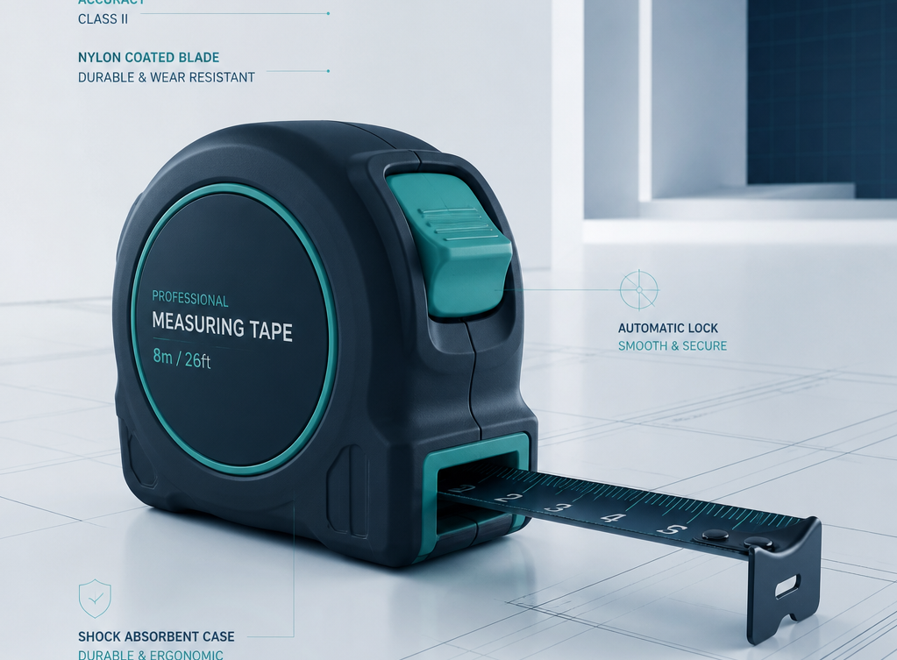
Measure the operating envelope before selecting a topology
Key metrics and iterative testing strategy for system capacity planning
Capacity inputs
Demand (requests/sec, concurrent users, resource mix), Latency (p50/p95/p99, search vs write, end-to-end), and Data (resources per patient, growth per day, index size).
Saturation
Monitoring CPU, heap, GC, DB IOPS, cache hit, and queue depth.
Iteration
Load test, identify bottleneck, change one variable, retest, set SLO plus headroom.
Iteration: load test, identify bottleneck, change one variable, retest, set SLO plus headroom.

Slide 20




Harden first, then build resilience, scale, and optimize
A structured roadmap for phased system maturity
0–30 days: Harden
30–90 days: Resilience
90–180 days: Scale
6–12 months: Optimize
TLS/domain, protect FHIR APIs, secrets manager, off-host backups, baseline telemetry.
Queue-backed workers, workload-driven index redesign, caching strategy, load/performance suite, autoscaling.
Managed/replicated MongoDB, multiple API replicas, ingress/WAF, E2E tests, restore/failover drills.
Tenant isolation, advanced search/index tier, analytics separation, multi- region if required, cost/performance tuning.

Slide 21
Prototype Value: Exposing Enterprise Service Demands
Key dimensions for evaluating service readiness and scale
Standards first
FHIR provides a durable interoperability boundary.
Simple architecture first
The compact stack accelerated learning and exposed integration behavior.
Operational rigor next
Security, HA, observability, recovery, and deployment controls dominate readiness.
Performance is empirical
Indexes, workload isolation, and capacity tests should drive scale decisions.

Slide 22
The pattern is proven; now engineer the operating envelope
Operational excellence for FHIR-based systems
Secure every API boundary
Implement robust authentication and authorization to protect all endpoints.
Scale stateless compute horizontally
Ensure system elasticity by maintaining stateless application architecture.
Engineer indexes from real FHIR searches
Optimize database performance based on actual query patterns and FHIR resource access.
Isolate bulk and async workloads
Prevent resource contention by separating batch processing from real-time API traffic.
Design HA, DR, and observability in
Build high availability, disaster recovery, and comprehensive monitoring directly into the architecture.
Q&A.

Slide 23


Appendix: Current Technology Stack
Overview of infrastructure, frameworks, and tools
Category
Technology / Tool
Standard
HL7 FHIR R4
FHIR Framework
HAPI FHIR 7.2.0 Plain Server
Backend
Spring Boot 3.2.5, Java 17
Database
MongoDB 7.0
Frontend
React 18, Vite 6, TypeScript, Tailwind 4
Runtime
Docker/Docker Compose, nginx, Caddy
CI/CD
GitHub Actions, GHCR
Synthetic Data
Synthea
Testing
Maven/JUnit slices, Vitest/RTL, Live smoke test

Slide 24
Appendix — security hardening checklist
Recommended security practices for infrastructure and application layers
Transport Security
TLS everywhere, HSTS, managed certificates.
Identity & Access
OAuth2/OIDC and SMART-on- FHIR scopes with audience validation.
Authorization
Protect /fhir/** with resource/action authorization.
API Gateway & WAF
Rate limits, quotas, and threat controls.
Secrets Management
Central secrets/KMS, rotation, no committed defaults.
Audit & Logging
Immutable audit events for reads, writes, and admin.
Network & Identities
Private data networking and least-privilege service identities.
Supply Chain Security
SAST/SCA/container scanning plus signed images/SBOM.
Compliance & Governance
HIPAA security risk analysis, logging controls, retention, and incident response.

